Slide 1
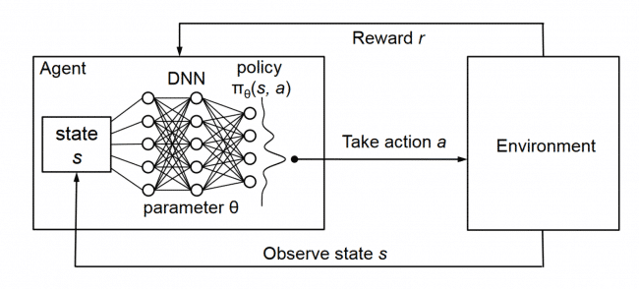
L9.3 Policy-based RL
Zonghua Gu 2023
Acknowledgement: slides based on https://www.coursera.org/specializations/reinforcement-learning
And textbook by Sutton and Barto http://incompleteideas.net/book/the-book-2nd.html

Slide 2



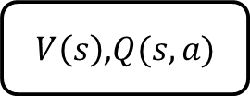




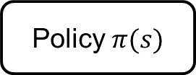


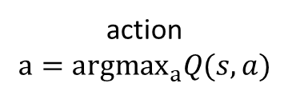
Policy-based RL
state $s$
action $a$
state $s$
action $a$
state $s$
action $a$
MDP
$V\left(s\right)$,$Q(s,a)$
Policy $π(s)$
next
state $s′$
reward $r$
action
$$a={argmax}_{a}Q(s,a)$$
action $a=π(s)$
MDP Planning | Value-based RL | Policy-based RL
Notes:
We use the Generalized Policy Iteration framework
to learn approximate action values.
Then we use these approximate values
indirectly to infer a good policy.
Now, we're interested in learning policies directly

Slide 3
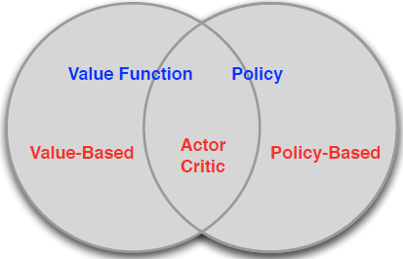
CH13 Policy Gradient Methods
Value Based
  Learnt Value Function
  Implicit policy (e.g. $ε$-greedy)
Policy Based
  No Value Function
  Learnt Policy
Actor-Critic
  Learnt Value Function
  Learnt Policy

Slide 4
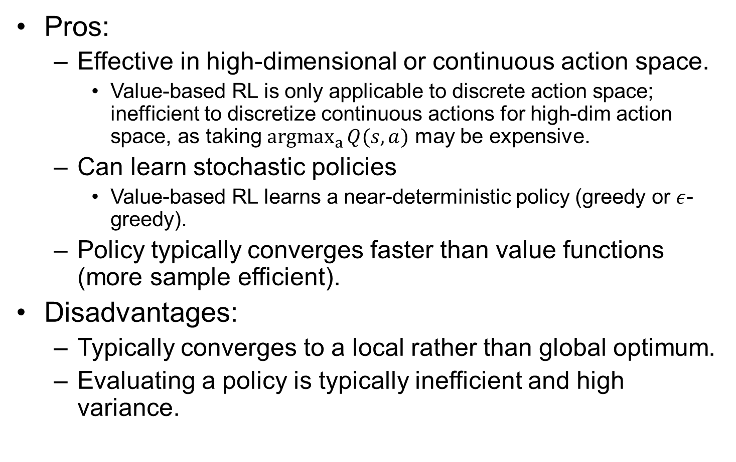
Policy-based RL Pros and Cons
Pros:
  Effective in high-dimensional or continuous action space.
    Value-based RL is only applicable to discrete action space; inefficient to discretize continuous actions for high-dim action space, as taking ${argmax}_{a}{Q(s,a)}$ may be expensive.
  Can learn stochastic policies
    Value-based RL learns a near-deterministic policy (greedy or $ε$-greedy).
  Policy typically converges faster than value functions (more sample efficient).
Disadvantages:
  Typically converges to a local rather than global optimum.
  Evaluating a policy is typically inefficient and high variance.
Notes:
For the game rock-paper-scissors, deterministic policy does not work well.

Slide 5
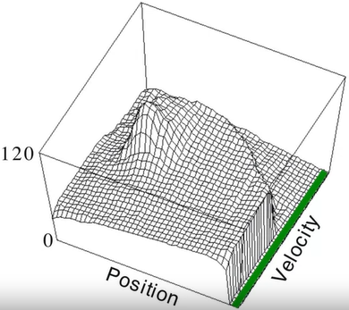
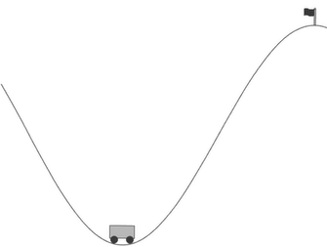
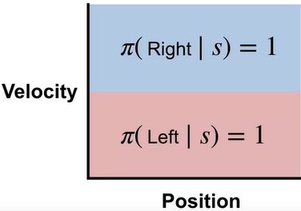
Mountain Car Example
An under-powered car situated in a valley wants to drive up a steep hill to reach the goal at the top of the rightmost hill. Due to gravity, the car cannot simply accelerate up the steep slope. It must learn to leverage potential energy by driving up the opposite hill before the car is able to make it to the goal.
Middle: a complex value function
Right: a simple policy that works well: accelerate in the direction of current velocity.
moving
right
moving
left

Slide 6
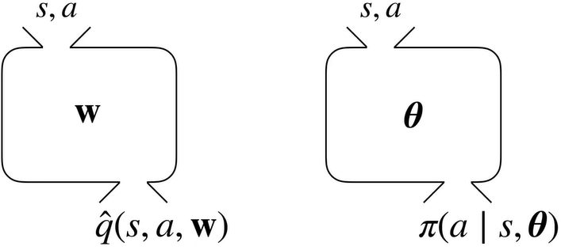
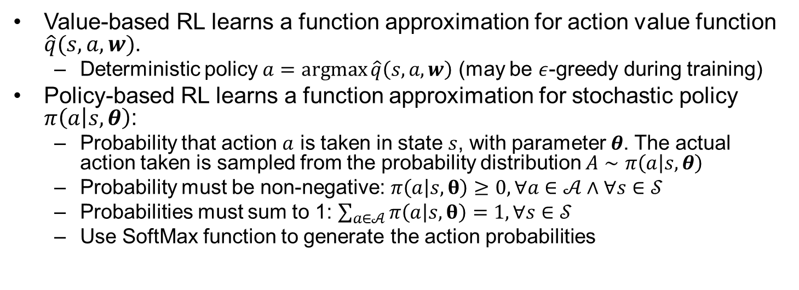
Function Approximation for Action Value Function vs. Policy
Value-based RL learns a function approximation for action value function $\hat{q}(s,a,w)$.
  Deterministic policy $a=\operatorname{argmax}{\hat{q}\left(s,a,w\right)}$ (may be $ε$-greedy during training)
Policy-based RL learns a function approximation for stochastic policy $π\left(a | s,θ\right)$:
  Probability that action $a$ is taken in state $s$, with parameter $θ$. The actual action taken is sampled from the probability distribution $A∼π\left(a | s,θ\right)$
  Probability must be non-negative: $π\left(a | s,θ\right)≥0, ∀a∈𝒜∧∀s∈𝒮$
  Probabilities must sum to 1: $\sum_{a∈𝒜}{π\left(a | s,θ\right)}=1,∀s∈𝒮$
  Use SoftMax function to generate the action probabilities
Notes:
Every iteration we will sample from this distribution (i.e. toss a biased coin) to get the actual move.

Slide 7
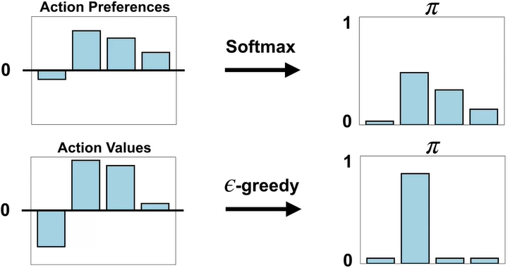
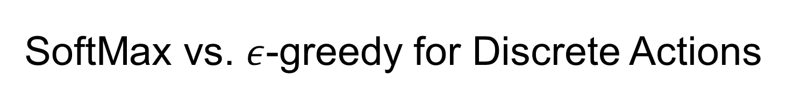


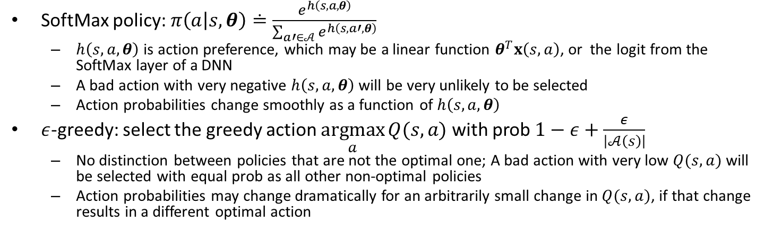
SoftMax vs. $ε$-greedy for Discrete Actions
SoftMax policy: $π\left(a | s,θ\right)≐\frac{e^{h\left(s,a,θ\right)}}{\sum_{a′∈𝒜}{e^{h\left(s,a′,θ\right)}}}$
  $h\left(s,a,θ\right)$ is action preference, which may be a linear function $θ^{T}x\left(s,a\right)$, or the logit from the SoftMax layer of a DNN
  A bad action with very negative $h\left(s,a,θ\right)$ will be very unlikely to be selected
  Action probabilities change smoothly as a function of $h\left(s,a,θ\right)$
$ε$-greedy: select the greedy action $\underset{a}{argmax}{Q(s,a)}$ with prob $1−ε+\frac{ε}{\left|𝒜\left(s\right)\right|}$
  No distinction between policies that are not the optimal one; A bad action with very low $Q(s,a)$ will be selected with equal prob as all other non-optimal policies
  Action probabilities may change dramatically for an arbitrarily small change in $Q(s,a)$, if that change results in a different optimal action
$$h\left(s,a,θ\right)$$
$$Q(s,a)$$
Notes:
Epsilon greedy: Very bad policy is still given certain probability
SoftMax: the agent can make its policy more greedy over time autonomously.
Well, in the beginning, the agent's estimates are not that accurate.
So you would want the agent to explore a lot.
As the estimates become more accurate, the agent should become more and more greedy.

Slide 8
Stochastic Policy vs. Deterministic Policy
Example 1: two-player game of rock-paper-scissors
  Scissors beat paper; paper beats rock; rock beats scissors
  For iterated game, a deterministic policy is easily exploited by the opponent; a uniform random policy is optimal, and achieves Nash equilibrium
Example 2: Aliased Grid World (POMDP)

Slide 9
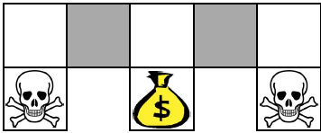
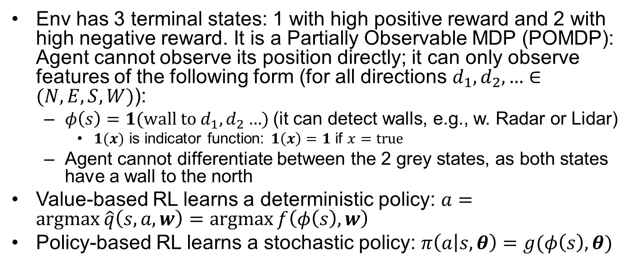
Aliased Grid World (POMDP)
Env has 3 terminal states: 1 with high positive reward and 2 with high negative reward. It is a Partially Observable MDP (POMDP): Agent cannot observe its position directly; it can only observe features of the following form (for all directions $d_{1},d_{2},…∈(N,E,S,W)$):
  $φ\left(s\right)=1(wall to d_{1},d_{2}…$) (it can detect walls, e.g., w. Radar or Lidar)
    $1(x)$ is indicator function: $1\left(x\right)=1$ if $x=true$
  Agent cannot differentiate between the 2 grey states, as both states have a wall to the north
Value-based RL learns a deterministic policy: $a=\operatorname{argmax}{\hat{q}\left(s,a,w\right)}=\operatorname{argmax}{f\left(φ\left(s\right),w\right)}$
Policy-based RL learns a stochastic policy: $π\left(a | s,θ\right)=g(φ\left(s\right),θ)$

Slide 10
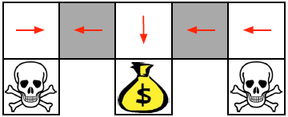
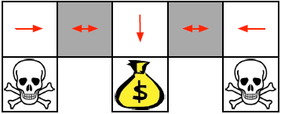
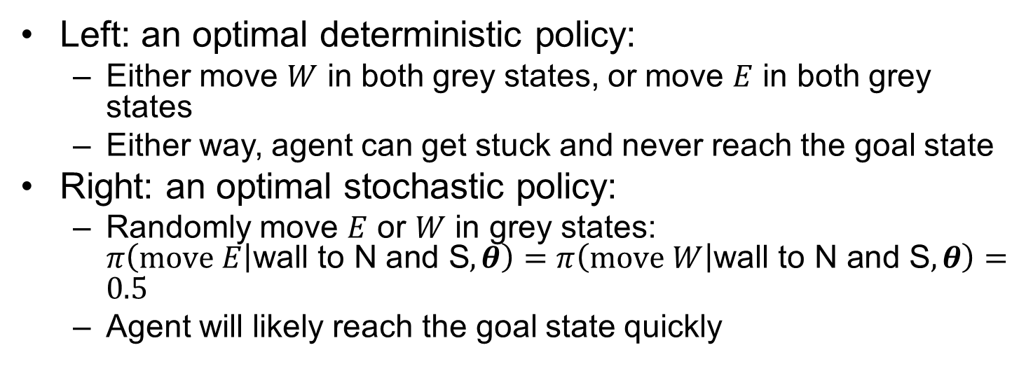
Aliased Grid World (POMDP)
Left: an optimal deterministic policy:
  Either move $W$ in both grey states, or move $E$ in both grey states
  Either way, agent can get stuck and never reach the goal state
Right: an optimal stochastic policy:
  Randomly move $E$ or $W$ in grey states: $π\left(move E | \text{wall} \text{to} \text{N} \text{and} \text{S},θ\right)=π\left(move W | \text{wall} \text{to} \text{N} \text{and} \text{S},θ\right)=0.5$
  Agent will likely reach the goal state quickly
Opt. deterministic policy
Opt. stochastic policy
Notes:
Value-based RL learns a near-deterministic policy (greedy or $ε$-greedy), So it may traverse the corridor for a long time. How about adding $ε$-greedy on top of the opt det policy?
Agent may get into one of the 2 bad states, since each non-optimal action is given equal probability in every state

Slide 11
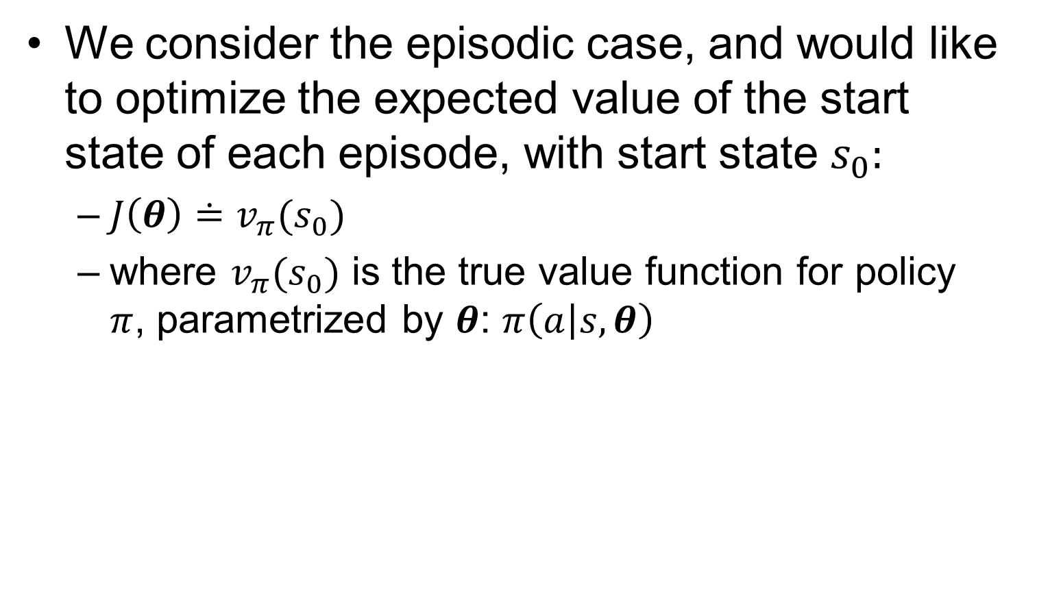
Optimization Objective
We consider the episodic case, and would like to optimize the expected value of the start state of each episode, with start state $s_{0}$:
  $J\left(θ\right)≐v_{π}(s_{0})$
  where $v_{π}(s_{0})$ is the true value function for policy $π$, parametrized by $θ$: $π\left(a | s,θ\right)$
Notes:
where v⇡✓ is the true value function for ⇡✓, the policy determined by ✓. From here on in
our discussion we will assume no discounting (# = 1) for the episodic case, although for
completeness we do include the possibility of discounting in the boxed algorithms.

Slide 12

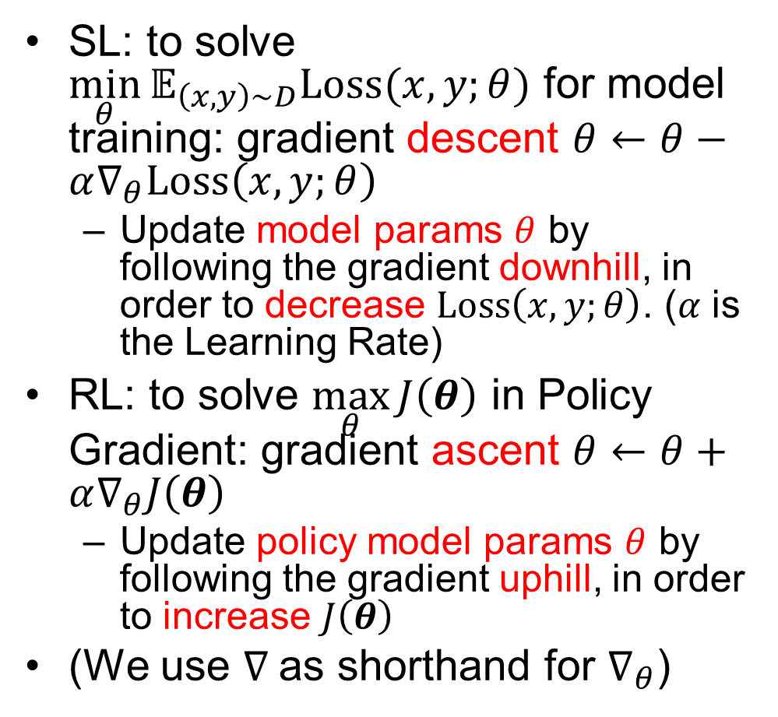



Model Training in Supervised Learning vs. Policy Gradient in RL
SL: to solve $\min_{θ}{𝔼_{\left(x,y\right)∼D}Loss(x,y;θ)}$ for model training: gradient descent $θ←θ−α∇_{θ}Loss\left(x,y;θ\right)$
  Update model params $θ$ by following the gradient downhill, in order to decrease $Loss\left(x,y;θ\right)$. ($α$ is the Learning Rate)
RL: to solve $\max_{θ}{J\left(θ\right)}$ in Policy Gradient: gradient ascent $θ←θ+α∇_{θ}J\left(θ\right)$
  Update policy model params $θ$ by following the gradient uphill, in order to increase $J\left(θ\right)$
(We use $∇$ as shorthand for $∇_{θ}$)
$$𝔼_{\left(x,y\right)∼D}Loss(x,y;θ)$$
$$θ$$
$$J\left(θ\right)$$
$$θ$$

Slide 13
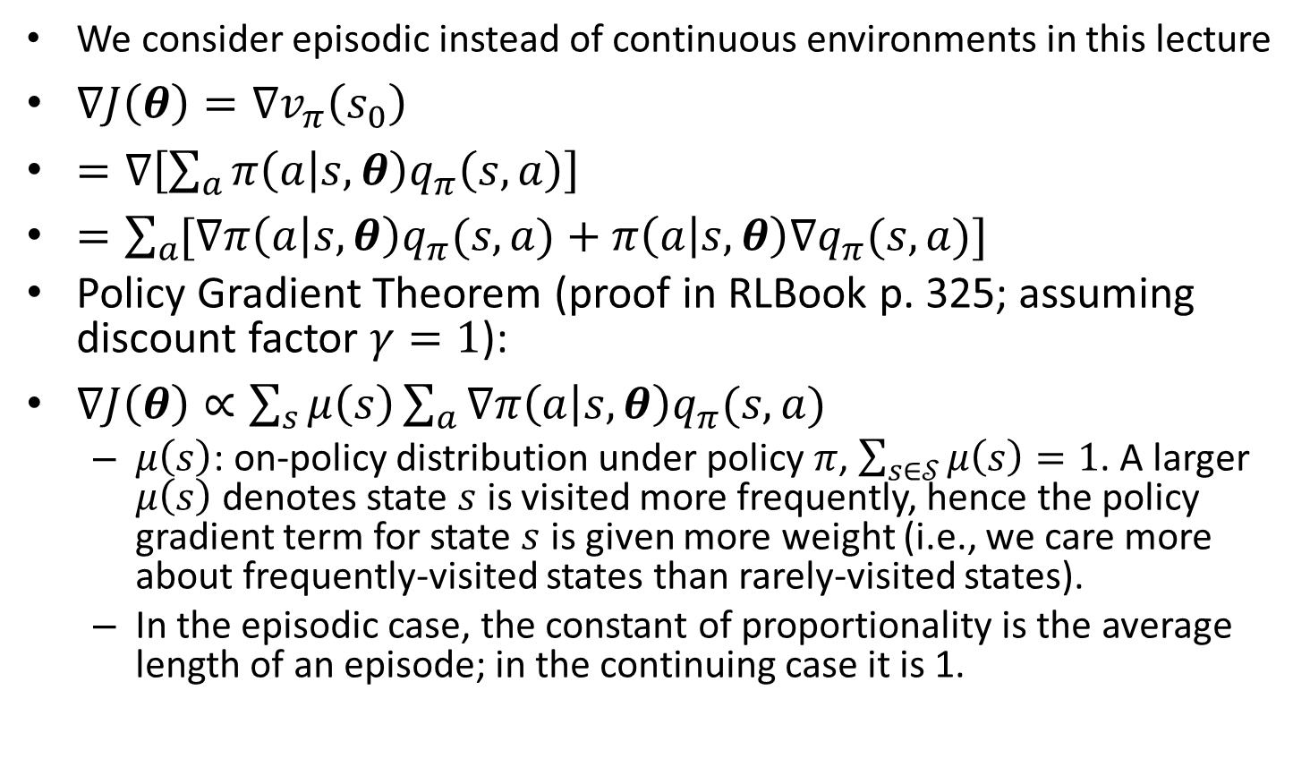
Policy Gradient Theorem
We consider episodic instead of continuous environments in this lecture
$∇J\left(θ\right)=∇v_{π}\left(s_{0}\right)$
$=∇\left[\sum_{a}{π\left(a | s,θ\right)q_{π}\left(s,a\right)}\right]$
$=\sum_{a}{[∇π\left(a | s,θ\right)q_{π}(s,a)}+π\left(a | s,θ\right)∇q_{π}(s,a)]$
Policy Gradient Theorem (proof in RLBook p. 325; assuming discount factor $γ=1$):
$∇J\left(θ\right)∝\sum_{s}{μ\left(s\right)}\sum_{a}{∇π\left(a | s,θ\right)q_{π}(s,a)}$
  $μ\left(s\right)$: on-policy distribution under policy $π$, $\sum_{s∈𝒮}{μ\left(s\right)}=1$. A larger $μ\left(s\right)$denotes state $s$ is visited more frequently, hence the policy gradient term for state $s$ is given more weight (i.e., we care more about frequently-visited states than rarely-visited states).
  In the episodic case, the constant of proportionality is the average length of an episode; in the continuing case it is 1.
Notes:
$$∇_{w}\overline{VE}=∇_{w}\sum_{s}{μ\left(s\right)}{\left[v_{π}\left(s\right)−\hat{v}\left(s,w\right)\right]}^{2}$$
$$θ←θ+α\sum_{a}{∇π\left(a | s,θ\right)q_{π}(s,a)}$$
For a given state $s$: gradient ascent maximizes average reward $\sum_{a}{π\left(a | s,θ\right)q_{π}(s,a)}$.
For all states:

Slide 14
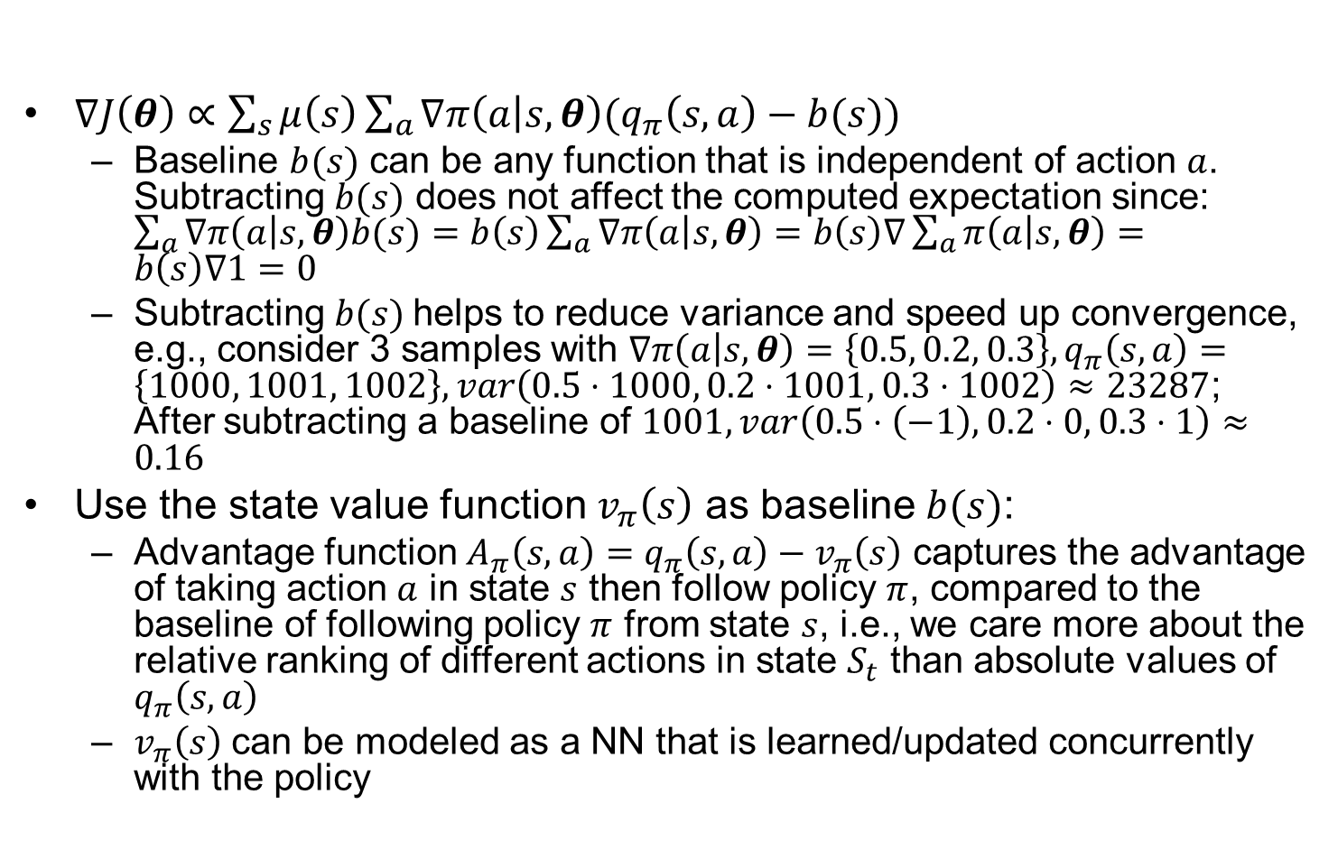
Policy Gradient with Baseline
$∇J\left(θ\right)∝\sum_{s}{μ\left(s\right)}\sum_{a}{∇π\left(a | s,θ\right)(q_{π}\left(s,a\right)}−b(s))$
  Baseline $b(s)$ can be any function that is independent of action $a$. Subtracting $b(s)$ does not affect the computed expectation since: $\sum_{a}{∇π\left(a | s,θ\right)b(s)}=b\left(s\right)\sum_{a}{∇π\left(a | s,θ\right)}=b\left(s\right)∇\sum_{a}{π\left(a | s,θ\right)}=b\left(s\right)∇1=0$
  Subtracting $b(s)$helps to reduce variance and speed up convergence, e.g., consider 3 samples with $∇π\left(a | s,θ\right)=\left\{0.5, 0.2, 0.3\right\},q_{π}\left(s,a\right)=\left\{1000, 1001, 1002\right\},var\left(0.5⋅1000, 0.2⋅1001, 0.3⋅1002\right)≈23287$; After subtracting a baseline of $1001, var\left(0.5⋅\left(−1\right), 0.2⋅0, 0.3⋅1\right)≈0.16$
Use the state value function $v_{π}\left(s\right)$ as baseline $b(s)$:
  Advantage function $A_{π}\left(s,a\right)=q_{π}\left(s,a\right)−v_{π}\left(s\right)$ captures the advantage of taking action $a$ in state $s$ then follow policy $π$, compared to the baseline of following policy $π$ from state $s$, i.e., we care more about the relative ranking of different actions in state $S_{t}$ than absolute values of $q_{π}\left(s,a\right)$
  $v_{π}\left(s\right)$ can be modeled as a NN that is learned/updated concurrently with the policy
Notes:
$$∇J\left(θ\right)=𝔼_{π}\left[log π\left(A_{t} | S_{t},θ\right)A_{π}\left(S_{t},A_{t}\right)\right],$$

Slide 15
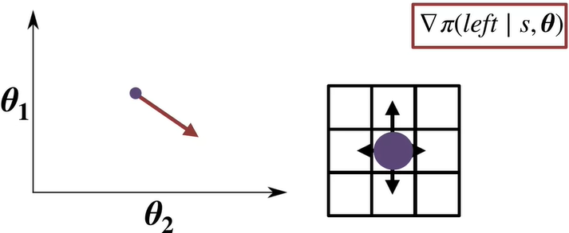
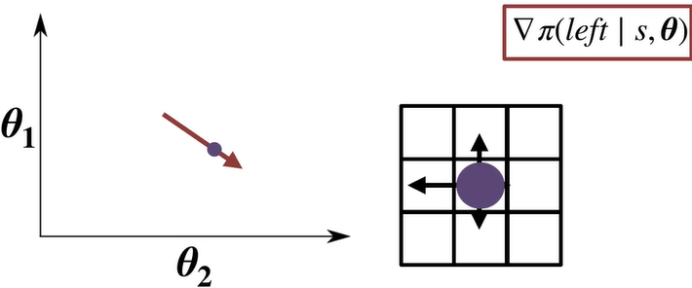
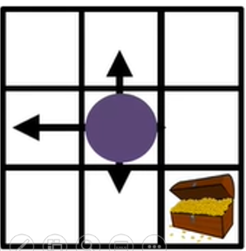
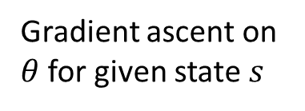
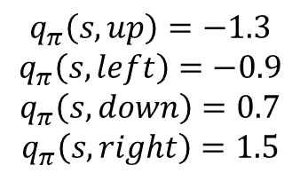
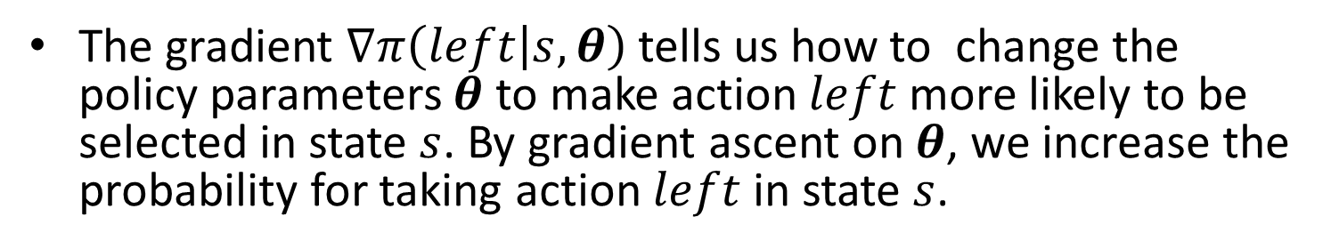
Policy Gradient Example
The gradient $∇π\left(left | s,θ\right)$tells us how to change the policy parameters $θ$ to make action $left$more likely to be selected in state $s$. By gradient ascent on $θ$, we increase the probability for taking action $left$ in state $s$.
Gradient ascent on $θ$ for given state $s$
$$q_{π}\left(s, up\right)=−1.3$$
$$q_{π}\left(s, left\right)=−0.9$$
$$q_{π}\left(s, down\right)=0.7$$
$$q_{π}\left(s, right\right)=1.5$$
After
grad. ascent

Slide 16
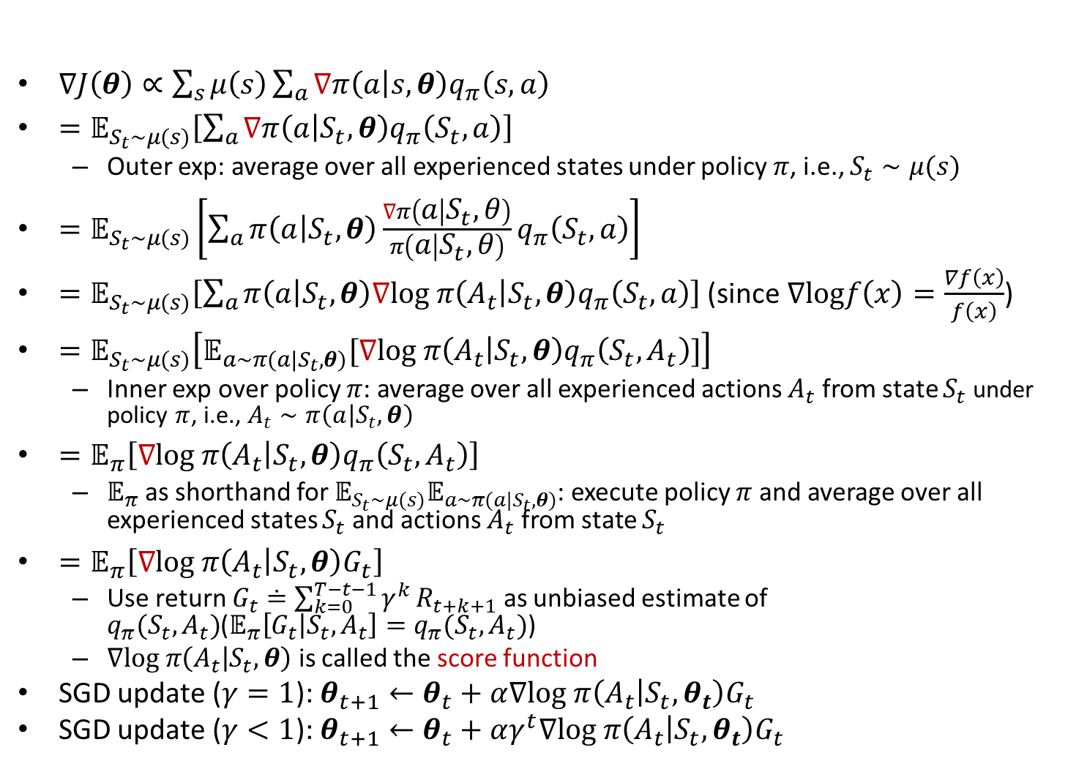
MC REINFORCE
$∇J\left(θ\right)∝\sum_{s}{μ\left(s\right)}\sum_{a}{∇π\left(a | s,θ\right)q_{π}\left(s,a\right)}$
$=𝔼_{S_{t}∼μ(s)}\left[\sum_{a}{∇π\left(a | S_{t},θ\right)q_{π}\left(S_{t},a\right)}\right]$
  Outer exp: average over all experienced states under policy $π$, i.e., $S_{t}∼μ(s)$
$=𝔼_{S_{t}∼μ(s)}\left[\sum_{a}{π\left(a | S_{t},θ\right)\frac{∇π\left(a | S_{t},θ\right)}{π\left(a | S_{t},θ\right)}q_{π}\left(S_{t},a\right)}\right]$
$=𝔼_{S_{t}∼μ(s)}\left[\sum_{a}{π\left(a | S_{t},θ\right)∇log π\left(A_{t} | S_{t},θ\right)q_{π}\left(S_{t},a\right)}\right]$ (since $∇logf\left(x\right)=\frac{∇f\left(x\right)}{f\left(x\right)}$)
$=𝔼_{S_{t}∼μ(s)}\left[𝔼_{a∼π(a|S_{t},θ)}[∇log π\left(A_{t} | S_{t},θ\right)q_{π}\left(S_{t},A_{t}\right)]\right]$
  Inner exp over policy $π$: average over all experienced actions $A_{t}$ from state $S_{t}$ under policy $π$, i.e., $A_{t}∼π\left(a | S_{t},θ\right)$
$=𝔼_{π}\left[∇log π\left(A_{t} | S_{t},θ\right)q_{π}\left(S_{t},A_{t}\right)\right]$
  $𝔼_{π}$as shorthand for $𝔼_{S_{t}∼μ(s)}𝔼_{a∼π(a|S_{t},θ)}$: execute policy $π$ and average over all experienced states $S_{t}$and actions $A_{t}$ from state $S_{t}$
$=𝔼_{π}\left[∇log π\left(A_{t} | S_{t},θ\right)G_{t}\right]$
  Use return $G_{t}≐\sum_{k=0}^{T−t−1}{γ^{k}}R_{t+k+1}$ as unbiased estimate of $q_{π}(S_{t},A_{t})$($𝔼_{π}\left[G_{t} | S_{t},A_{t}\right]=q_{π}(S_{t},A_{t})$)
  $∇log π\left(A_{t} | S_{t},θ\right)$ is called the score function
SGD update ($γ=1$): $θ_{t+1}←θ_{t}+α∇log π\left(A_{t} | S_{t},θ_{t}\right)G_{t}$
SGD update ($γ<1$): $θ_{t+1}←θ_{t}+αγ^{t}∇log π\left(A_{t} | S_{t},θ_{t}\right)G_{t}$
Notes:
One way to approximate $q_{π}\left(S_{t}, A_{t}\right)$ is by taking expectation over the return $G_{t}$ in every episode for taking action $A_{t}$ in state $S_{t}$
Taking exp over policy $π$: execute policy $π$ and average over all experienced states $s$)
(execute policy $π$ and average over all experienced states $s$)
$q_{π}\left(S_{t},A_{t}\right)$: action value function
$∇log π\left(A_{t} | S_{t},θ\right)$: score function
$$r\left(π\right)=\sum_{s}{μ\left(s\right)}\sum_{a}{π\left(a | s,θ\right)\sum_{r,s^{′}}{p\left(r,s′ | s,a\right)r}}$$
$=𝔼_{π}\left[G_{t}\frac{∇π\left(A_{t} | S_{t},θ\right)}{π\left(A_{t} | S_{t},θ\right)}\right]$ (since $𝔼_{π}\left[G_{t} | S_{t},A_{t}\right]=q_{π}\left(S_{t},A_{t}\right)$)
$$=θ+αG_{t}∇\ln{π\left(A_{t} | S_{t},θ\right)}$$

Slide 17
MC REINFORCE Example
Consider a given state $S$ with two possible actions UP and DOWN. Initially $π\left(U | S,θ_{t}\right)=.9,π\left(D | S, θ_{t}\right)=.1$. Consider one episode with 9 occurrences of $(S,U)$ at steps $t1, t2, …, t9$with return $G_{t1}=…=G_{t9}=1$, and 1 occurrence of $(S,D)$ at step $t10$ with return $G_{t10}=2$. SGD update: $θ_{t+1}←θ_{t}+∇log π\left(A_{t} | S_{t},θ_{t}\right)G_{t}$. At the end of the episode, the parameters are updated as follows:
Correct update sequence with $∇log π=\frac{1}{π}∇π$:
  1st update at step $t1$: $θ_{t1+1}=θ_{t1}+αγ^{t1}∇log π\left(A_{t1} | S_{t1},θ_{t1}\right)G_{t1}=θ_{t1}+\frac{1}{.9}αγ^{t1}∇π\left(U | S,θ_{t1}\right)⋅1$
  2nd update at step $t2$: $θ_{t2+1}=θ_{t2}+αγ^{t2}∇log π\left(A_{t2} | S_{t2},θ_{t2}\right)G_{t2}=θ_{t2}+\frac{1}{.9}αγ^{t2}∇π\left(U | S,θ_{t2}\right)⋅1$
  …
  9th update at step $t9$: $θ_{t9+1}=θ_{t9}+αγ^{t9}∇log π\left(A_{t9} | S_{t9},θ_{t9}\right)G_{t9}=θ_{t9}+\frac{1}{.9}αγ^{t9}∇π\left(U | S,θ_{t9}\right)⋅1$
  10th update at step $t10$: $θ_{t10+1}=θ_{t10}+αγ^{t10}∇log π\left(A_{t10} | S_{t10},θ_{t10}\right)G_{t10}=θ_{t10}+\frac{1}{.1 }αγ^{t10}∇π\left(D | S,θ_{t10}\right)⋅2$
Incorrect update sequence with $∇π$:
  1st update at step $t1$: $θ_{t1+1}=θ_{t1}+αγ^{t1}∇log π\left(A_{t1} | S_{t1},θ_{t1}\right)G_{t1}=θ_{t1}+αγ^{t1}∇π\left(U | S,θ_{t1}\right)⋅1$
  2nd update at step $t2$: $θ_{t2+1}=θ_{t2}+αγ^{t2}∇log π\left(A_{t2} | S_{t2},θ_{t2}\right)G_{t2}=θ_{t2}+αγ^{t2}∇π\left(U | S, θ_{t2}\right)⋅1$
  …
  9th update at step $t9$: $θ_{t9+1}=θ_{t9}+αγ^{t9}∇log π\left(A_{t9} | S_{t9},θ_{t9}\right)G_{t9}=θ_{t9}+αγ^{t9}∇π\left(U | S,θ_{t9}\right)⋅1$
  10th update at step $t10$: $θ_{t10+1}=θ_{t10}+αγ^{t10}∇log π\left(A_{t10} | S_{t10},θ_{t10}\right)G_{t10}=θ_{t10}+αγ^{t10}∇π\left(D | S,θ_{t10}\right)⋅2$
The correct update sequence gives roughly equal weight to the two action choices with return of $1$ (action $U$ in state $S$, experienced 9 times) and return of $2$ (action $D$ in state $S$, experienced once), so $θ$ will be updated towards preferring action $D$ in state $S$
The incorrect update sequence gives roughly 9 times the weight to the action choice with return of $1$ (action $U$ in state $S$, experienced 9 times) than the action choice with return of $2$ (action $D$ in state $S$, experienced once), so $θ$ will be incorrectly updated towards preferring action $U$ in state $S$
“The update increases the parameter vector in this direction proportional to the return, and inversely proportional to the action probability. The former makes sense because it causes the parameter to move most in the directions that favor actions that yield the highest return. The latter makes sense because otherwise actions that are selected frequently are at an advantage (the updates will be more often in their direction) and might win out even if they do not yield the highest return.” – RLBook p. 327
Notes:
Caveat: as $θ$ is updated at each step, $π\left(U | S,θ_{t}\right)$ may deviate from .9/.1. Hence the first update sequence may not have .9/.1 in the denominator. This example just illustrates the basic idea.
Afterwards $π\left(A_{1} | S_{t1+1},θ_{t1+1}\right)=\frac{2}{3}+ε_{1}$
100th update at step $t100$: $θ_{t100+1}=θ_{t100}+∇log π\left(A_{t1+2} | S_{t1+2},θ_{t1+2}\right)G_{t1+2}=θ_{t1+2}+\frac{1}{1−\frac{2}{3}−ε_{2}}∇π\left(A_{2} | S_{t1+2},θ_{t1+2}\right)⋅2$. Afterwards $π\left(A_{2} | S_{t1+3},θ_{t1+3}\right)=\frac{1}{3}+ε_{3}$

Slide 18
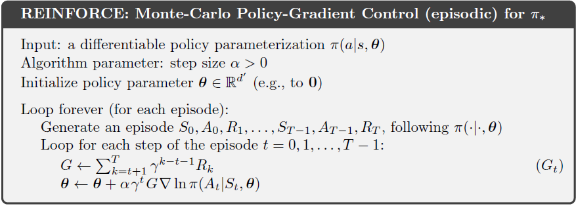
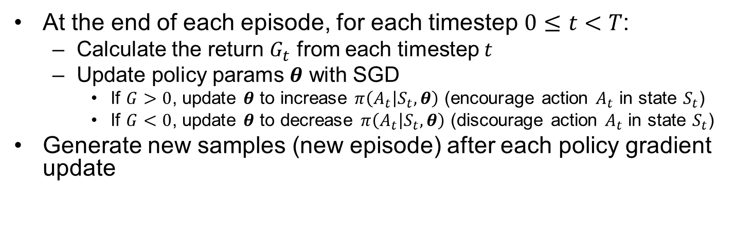
MC REINFORCE Pseudo-Code
At the end of each episode, for each timestep $0≤t<T$:
  Calculate the return $G_{t}$ from each timestep $t$
  Update policy params $θ$ with SGD
    If $G>0$, update $θ$ to increase $π\left(A_{t} | S_{t},θ\right)$ (encourage action $A_{t}$ in state $S_{t}$)
    If $G<0$, update $θ$ to decrease $π\left(A_{t} | S_{t},θ\right)$ (discourage action $A_{t}$ in state $S_{t}$)
Generate new samples (new episode) after each policy gradient update
Notes:
This code assumes learning rate $α=1$ for MC (every-visit), so $V\left(S_{t}\right)←V\left(S_{t}\right)+α\left(G_{t}−V\left(S_{t}\right)\right)=G_{t}$

Slide 19
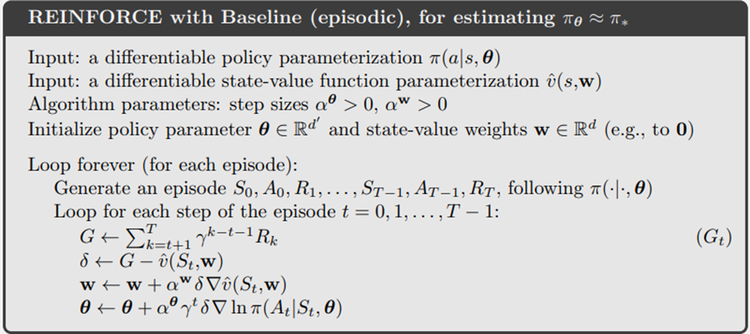
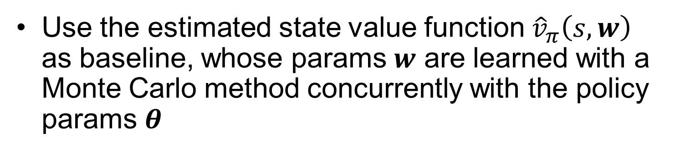
MC REINFORCE with Baseline
Use the estimated state value function ${\hat{v}}_{π}\left(s,w\right)$ as baseline, whose params $w$ are learned with a Monte Carlo method concurrently with the policy params $θ$

Slide 20
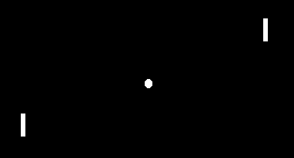
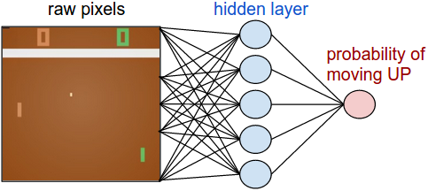
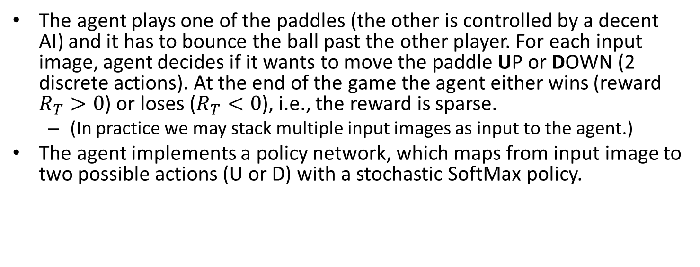
Example: Game of Pong
The agent plays one of the paddles (the other is controlled by a decent AI) and it has to bounce the ball past the other player. For each input image, agent decides if it wants to move the paddle UP or DOWN (2 discrete actions). At the end of the game the agent either wins (reward $R_{T}>0$) or loses ($R_{T}<0$), i.e., the reward is sparse.
  (In practice we may stack multiple input images as input to the agent.)
The agent implements a policy network, which maps from input image to two possible actions (U or D) with a stochastic SoftMax policy.
http://karpathy.github.io/2016/05/31/rl/
Notes:
After every single choice the game simulator executes the action and gives a reward after some time: Either a +1 reward if the ball went past the opponent, a -1 reward if agent missed the ball, or 0 otherwise.

Slide 21
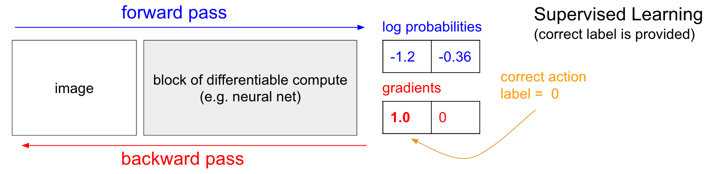
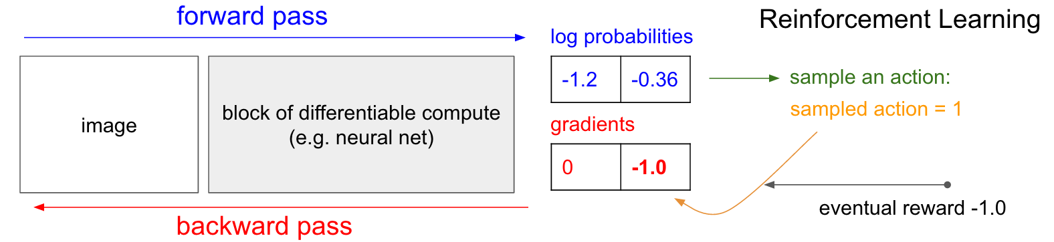
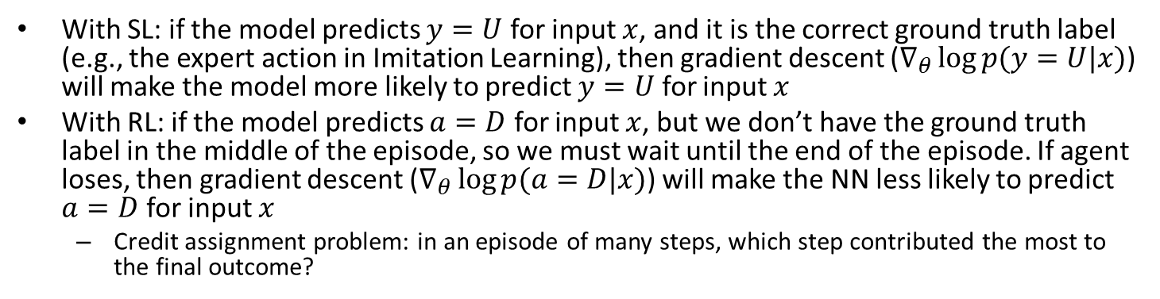
Supervised vs. Reinforcement Learning
With SL: if the model predicts $y=U$ for input $x$, and it is the correct ground truth label (e.g., the expert action in Imitation Learning), then gradient descent ($∇_{θ}\log{p(y=U|x)}$) will make the model more likely to predict $y=U$ for input $x$
With RL: if the model predicts $a=D$ for input $x$, but we don’t have the ground truth label in the middle of the episode, so we must wait until the end of the episode. If agent loses, then gradient descent ($∇_{θ}\log{p(a=D|x)}$) will make the NN less likely to predict $a=D$ for input $x$
  Credit assignment problem: in an episode of many steps, which step contributed the most to the final outcome?
logit
logit
http://karpathy.github.io/2016/05/31/rl/

Slide 22
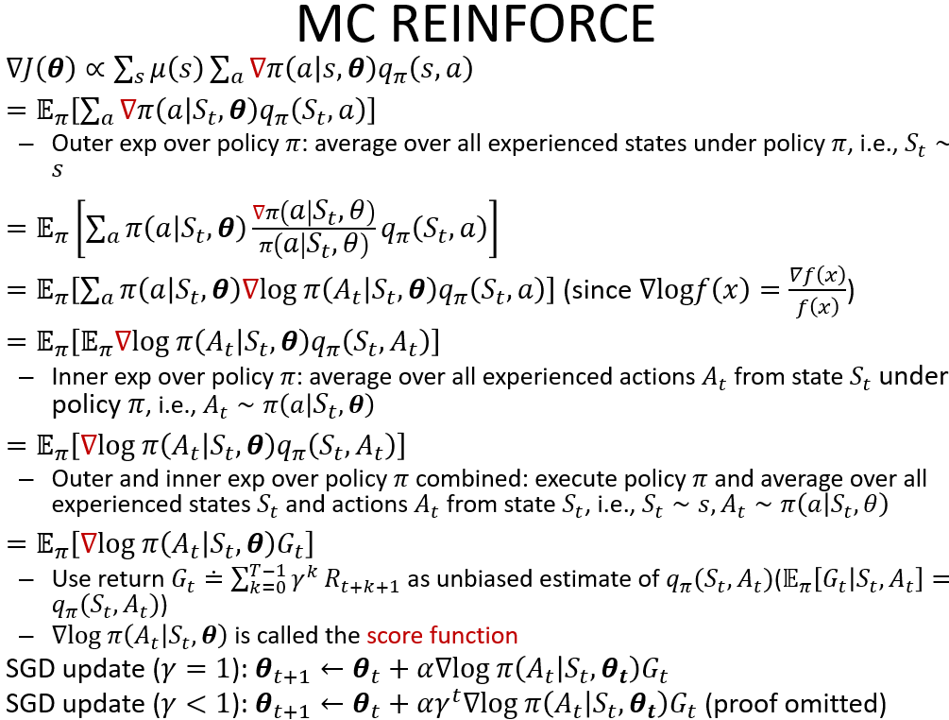
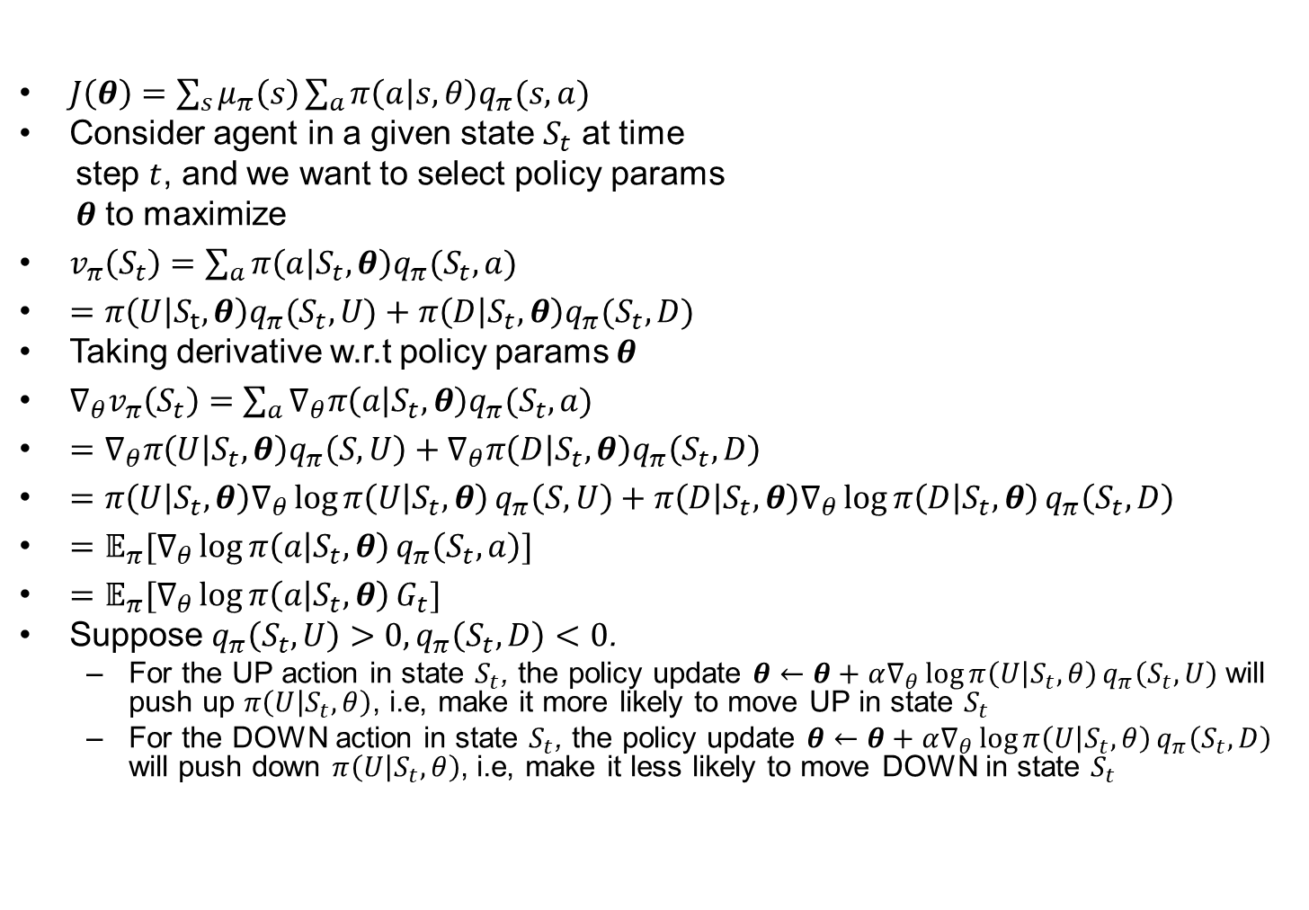
MC REINFORCE for Pong I
$J\left(θ\right)=\sum_{s}{μ_{π}\left(s\right)}\sum_{a}{π\left(a | s,θ\right)q_{π}(s,a)}$
Consider agent in a given state $S_{t}$ at time
step $t$, and we want to select policy params
$θ$ to maximize
$v_{π}\left(S_{t}\right)=\sum_{a}{π\left(a | S_{t},θ\right)q_{π}(S_{t},a)}$
$=π\left(U | S_{t},θ\right)q_{π}(S_{t}, U)+π\left(D | S_{t},θ\right)q_{π}(S_{t}, D)$
Taking derivative w.r.t policy params $θ$
$∇_{θ}v_{π}\left(S_{t}\right)=\sum_{a}{∇_{θ}π\left(a | S_{t},θ\right)q_{π}(S_{t},a)}$
$=∇_{θ}π\left(U | S_{t},θ\right)q_{π}\left(S, U\right)+∇_{θ}π\left(D | S_{t},θ\right)q_{π}\left(S_{t}, D\right)$
$=π\left(U | S_{t},θ\right)∇_{θ}\log{π\left(U | S_{t},θ\right)}q_{π}\left(S, U\right)+π\left(D | S_{t},θ\right)∇_{θ}\log{π\left(D | S_{t},θ\right)}q_{π}\left(S_{t}, D\right)$
$=𝔼_{π}[∇_{θ}\log{π\left(a | S_{t},θ\right)}q_{π}\left(S_{t}, a\right)]$
$=𝔼_{π}[∇_{θ}\log{π\left(a | S_{t},θ\right)}G_{t}]$
Suppose $q_{π}\left(S_{t}, U\right)>0,q_{π}\left(S_{t}, D\right)<0$.
  For the UP action in state $S_{t}$, the policy update $θ←θ+α∇_{θ}\log{π\left(U | S_{t},θ\right)}q_{π}\left(S_{t}, U\right)$ will push up $π\left(U | S_{t},θ\right)$, i.e, make it more likely to move UP in state $S_{t}$
  For the DOWN action in state $S_{t}$, the policy update $θ←θ+α∇_{θ}\log{π\left(U | S_{t},θ\right)}q_{π}\left(S_{t}, D\right)$ will push down $π\left(U | S_{t},θ\right)$, i.e, make it less likely to move DOWN in state $S_{t}$
Notes:
$$E_{a}f\left(x\right)=p_{θ}\left(x_{1}\right)f\left(x_{1}\right)+p_{θ}\left(x_{2}\right)f\left(x_{2}\right)$$
$$∇_{θ}E_{x}f\left(x\right)=∇_{θ}p_{θ}\left(x_{1}\right)f\left(x_{1}\right)+∇_{θ}p_{θ}\left(x_{2}\right)f\left(x_{2}\right)=p_{θ}\left(x_{1}\right)∇_{θ}\log{p_{θ}\left(x_{1}\right)}f\left(x_{1}\right)+p_{θ}\left(x_{2}\right)∇_{θ}\log{p_{θ}\left(x_{2}\right)}f\left(x_{2}\right)=E_{x}\left[∇_{θ}\log{p_{θ}\left(x\right)}f\left(x\right)\right]$$
Suppose $f\left(x_{1}\right)=1,f\left(x_{2}\right)=−1$
GD $θ←θ+α∇_{θ}\log{p_{θ}\left(x\right)}f\left(x\right)$ will push up $p_{θ}\left(x_{1}\right)$ and push down push up $p_{θ}\left(x_{2}\right)$, make prob density higher at $x_{1}$, lower at $x_{2}$

Slide 23
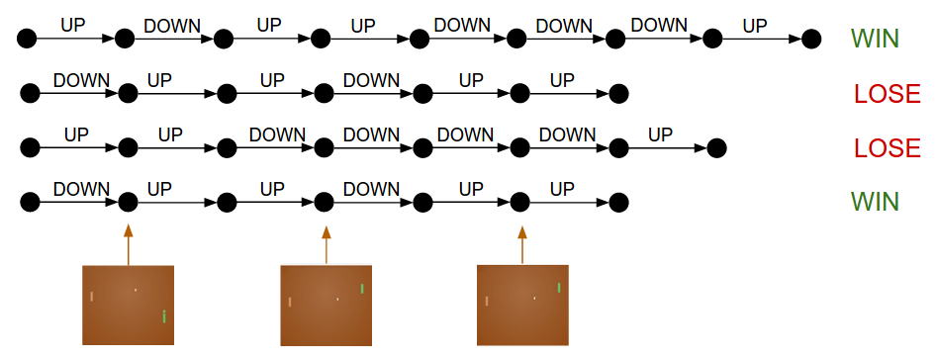
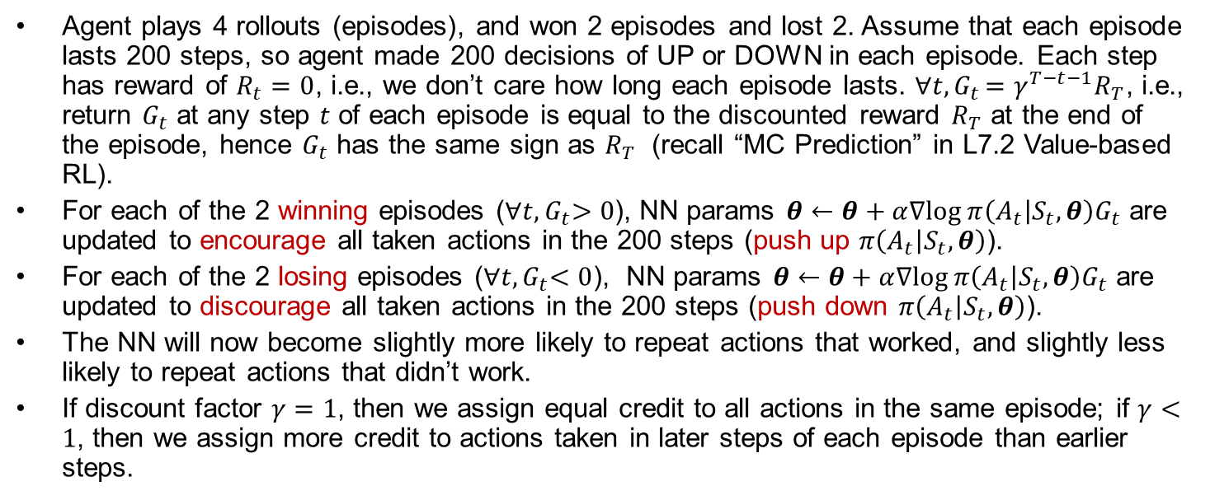
MC REINFORCE for Pong II
Agent plays 4 rollouts (episodes), and won 2 episodes and lost 2. Assume that each episode lasts 200 steps, so agent made 200 decisions of UP or DOWN in each episode. Each step has reward of $R_{t}=0$, i.e., we don’t care how long each episode lasts. $∀t{, G}_{t}=γ^{T−t−1}R_{T}$, i.e., return $G_{t}$ at any step $t$ of each episode is equal to the discounted reward $R_{T}$ at the end of the episode, hence $G_{t}$ has the same sign as $R_{T}$ (recall “MC Prediction” in L7.2 Value-based RL).
For each of the 2 winning episodes (${∀t,G}_{t}>0$), NN params $θ←θ+α∇log π\left(A_{t} | S_{t},θ\right)G_{t}$ are updated to encourage all taken actions in the 200 steps (push up $π\left(A_{t} | S_{t},θ\right)$).
For each of the 2 losing episodes (${∀t,G}_{t}<0$), NN params $θ←θ+α∇log π\left(A_{t} | S_{t},θ\right)G_{t}$ are updated to discourage all taken actions in the 200 steps (push down $π\left(A_{t} | S_{t},θ\right)$).
The NN will now become slightly more likely to repeat actions that worked, and slightly less likely to repeat actions that didn’t work.
If discount factor $γ=1$, then we assign equal credit to all actions in the same episode; if $γ<1$, then we assign more credit to actions taken in later steps of each episode than earlier steps.
Notes:
and for each one of these we know the parameter gradient, which tells us how we should change the parameters if we wanted to encourage that decision in that state in the future. All that remains now is to label every decision we’ve made as good or bad.
Fig below: all action we made in that episode. Conversely, we would also take the two games we lost and slightly discourage every single action we made in that episode. $∀t{, G}_{t}=R_{T}$; If discount factor $γ<1$, then

Slide 24





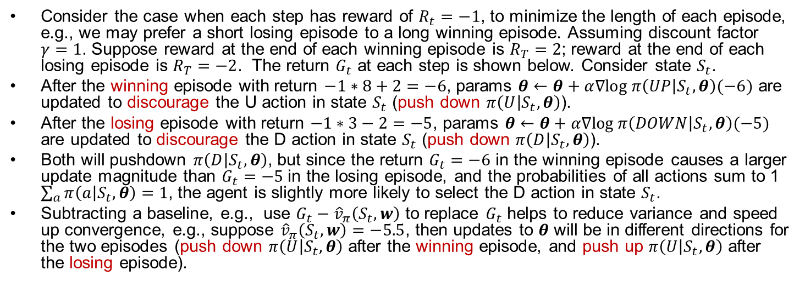











MC REINFORCE for Pong III
Consider the case when each step has reward of $R_{t}=−1$, to minimize the length of each episode, e.g., we may prefer a short losing episode to a long winning episode. Assuming discount factor $γ=1$. Suppose reward at the end of each winning episode is $R_{T}=2$; reward at the end of each losing episode is $R_{T}=−2$. The return $G_{t}$ at each step is shown below. Consider state $S_{t}$.
After the winning episode with return $−1∗8+2=−6$, params $θ←θ+α∇log π\left(UP | S_{t},θ\right)(−6)$ are updated to discourage the U action in state $S_{t}$ (push down $π\left(U | S_{t},θ\right)$).
After the losing episode with return $−1∗3−2=−5$, params $θ←θ+α∇log π\left(DOWN | S_{t},θ\right)(−5)$ are updated to discourage the D action in state $S_{t}$ (push down $π\left(D | S_{t},θ\right)$).
Both will pushdown $π\left(D | S_{t},θ\right)$, but since the return $G_{t}=−6$ in the winning episode causes a larger update magnitude than $G_{t}=−5$ in the losing episode, and the probabilities of all actions sum to 1 $\sum_{a}{π\left(a | S_{t},θ\right)}=1$, the agent is slightly more likely to select the D action in state $S_{t}$.
Subtracting a baseline, e.g., use $G_{t}−{\hat{v}}_{π}\left(S_{t}, w\right)$ to replace $G_{t}$ helps to reduce variance and speed up convergence, e.g., suppose ${\hat{v}}_{π}\left(S_{t}, w\right)=−5.5$, then updates to $θ$ will be in different directions for the two episodes (push down $π\left(U | S_{t},θ\right)$ after the winning episode, and push up $π\left(U | S_{t},θ\right)$ after the losing episode).
$$−6$$
$$−5$$
$$−4$$
$$−3$$
$$−2$$
$$−1$$
$$0$$
$$1$$
$$2$$
WIN
$$−5$$
$$−4$$
$$−3$$
$$−2$$
LOSE
State $S_{t}$
Notes:
and for each one of these we know the parameter gradient, which tells us how we should change the parameters if we wanted to encourage that decision in that state in the future. All that remains now is to label every decision we’ve made as good or bad.
Fig below: all action we made in that episode. Conversely, we would also take the two games we lost and slightly discourage every single action we made in that episode.

Slide 25
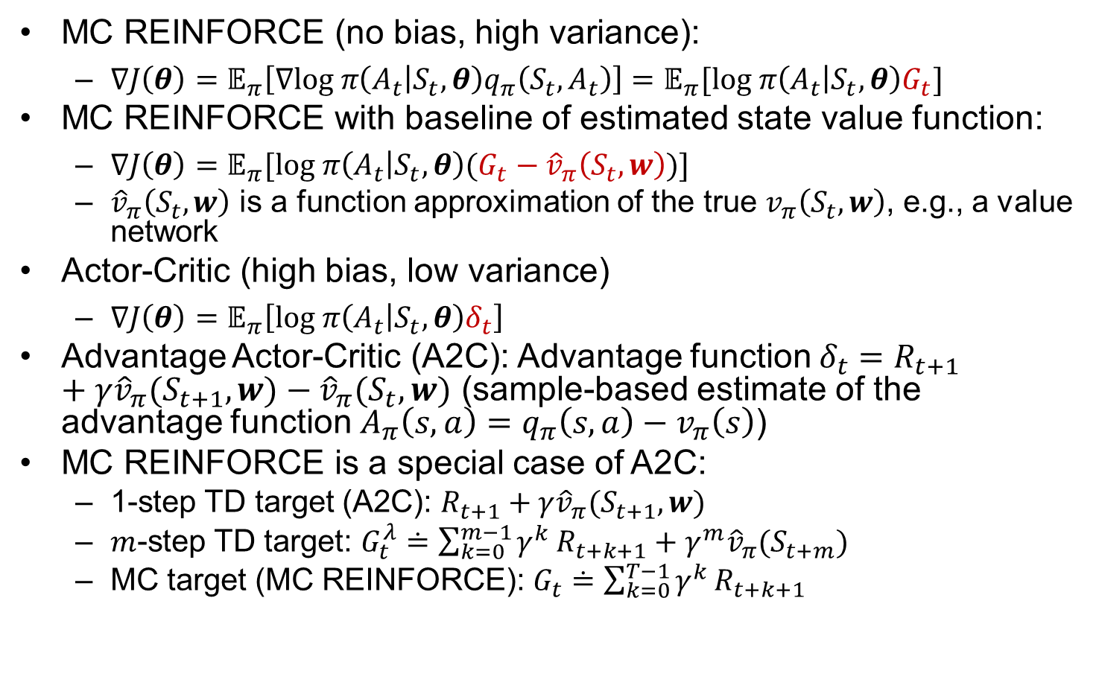
PG Variants
MC REINFORCE (no bias, high variance):
  $∇J\left(θ\right)=𝔼_{π}\left[∇log π\left(A_{t} | S_{t},θ\right)q_{π}\left(S_{t},A_{t}\right)\right]=𝔼_{π}[log π\left(A_{t} | S_{t},θ\right)G_{t}]$
MC REINFORCE with baseline of estimated state value function:
  $∇J\left(θ\right)=𝔼_{π}[log π\left(A_{t} | S_{t},θ\right)(G_{t}−{\hat{v}}_{π}\left(S_{t}, w\right))]$
  ${\hat{v}}_{π}\left(S_{t}, w\right)$ is a function approximation of the true $v_{π}\left(S_{t}, w\right)$, e.g., a value network
Actor-Critic (high bias, low variance)
  $∇J\left(θ\right)=𝔼_{π}\left[log π\left(A_{t} | S_{t},θ\right)δ_{t}\right]$
Advantage Actor-Critic (A2C): Advantage function $δ_{t}=R_{t+1}+γ{\hat{v}}_{π}(S_{t+1}, w)−{\hat{v}}_{π}(S_{t}, w)$ (sample-based estimate of the advantage function $A_{π}\left(s,a\right)=q_{π}\left(s,a\right)−v_{π}\left(s\right)$)
MC REINFORCE is a special case of A2C:
  1-step TD target (A2C): $R_{t+1}+γ{\hat{v}}_{π}(S_{t+1}, w)$
  $m$-step TD target: $G_{t}^{λ}≐\sum_{k=0}^{m−1}{γ^{k}}R_{t+k+1}+γ^{m}{\hat{v}}_{π}(S_{t+m})$
  MC target (MC REINFORCE): $G_{t}≐\sum_{k=0}^{T−1}{γ^{k}}R_{t+k+1}$
https://towardsdatascience.com/understanding-actor-critic-methods-931b97b6df3f
Notes:
(sample-based estimate of the action value function $q_{π}\left(s,a\right)$
, since $q_{π}\left(s,a\right)=\sum_{{r, s}^{′}}{p\left(r,s′ | s,a\right)}\left[r+γv_{π}\left(s^{′}\right)\right]=𝔼_{r,s′}[r+γv_{π}\left(s^{′}\right)$
Q Actor-Critic:
$∇J\left(θ\right)=𝔼_{π}[log π\left(A_{t} | S_{t},θ\right){\hat{q}}_{π}\left(S_{t},A_{t}\right)]$
$$θ_{t+1}←θ_{t}+α∇log π\left(A_{t} | S_{t},θ_{t}\right)A_{π}\left(S_{t},A_{t}\right)$$
$$θ_{t+1}←θ_{t}+α∇log π\left(A_{t} | S_{t},θ_{t}\right)G_{t}$$
$$θ_{t+1}←θ_{t}+α∇log π\left(A_{t} | S_{t},θ_{t}\right)\left(G_{t}−\hat{v}\left(S_{t}, w\right)\right)$$
$$θ_{t+1}←θ_{t}+α∇log π\left(A_{t} | S_{t},θ_{t}\right)δ_{t}$$
$$θ_{t+1}←θ_{t}+α∇log π\left(A_{t} | S_{t},θ_{t}\right){\hat{q}}_{π}\left(S_{t},A_{t}\right)$$
Critic uses policy evaluation (e.g. MC or TD learning) to estimate $q_{π}\left(S_{t},A_{t}\right),A_{π}\left(S_{t},A_{t}\right)$
subtract the baseline reward $\hat{v}\left(S_{t},w\right)$ to reduce variance of the TD error $δ_{t}$, since we only care about the relative ranking of different actions in state $S_{t}$. The baseline does not affect the expected update since $𝔼_{π}\left[∇_{θ}\ln{π\left(A_{t} | S_{t},θ\right)}\hat{v}\left(S_{t},w\right) | S_{t}=s\right]=0$
Original REINFORCE:
Is it correct TD error $δ_{t}=R_{t+1}−\overline{R}+\hat{v}\left(S_{t+1},w\right)−\hat{v}\left(S_{t},w\right)$

Slide 26
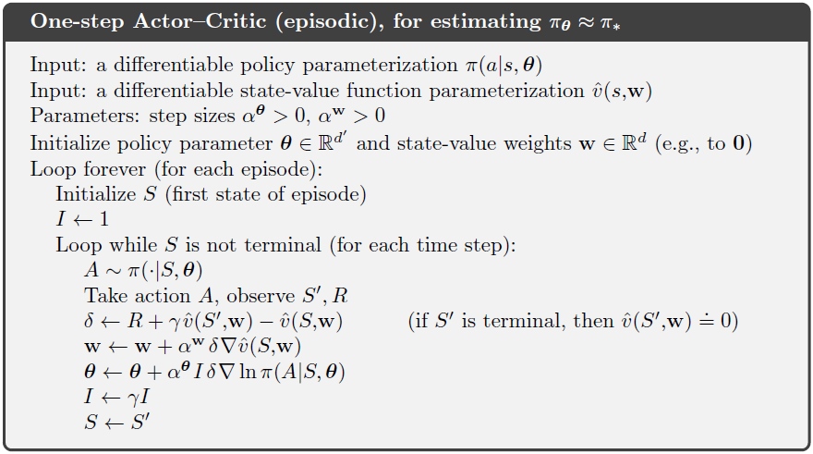
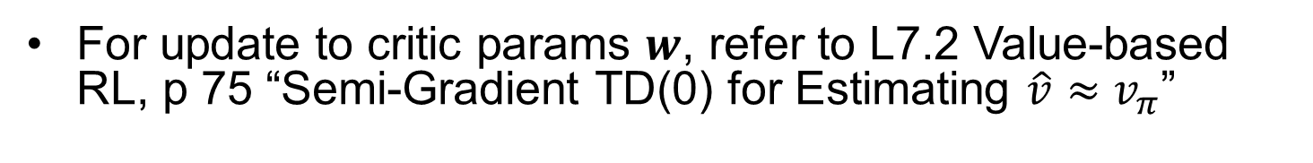
One-Step A2C Pseudo-Code
For update to critic params $w$, refer to L7.2 Value-based RL, p 75 “Semi-Gradient TD(0) for Estimating $\hat{v}≈v_{π}$”

Slide 27
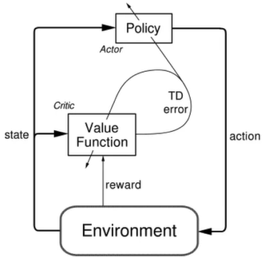


A2C Explanations
After each step of taking action $A_{t}$ in state $S_{t}$:
Critic computes TD error $δ_{t}=R_{t+1}+γ\hat{v}\left(S_{t+1},w\right)−\hat{v}\left(S_{t},w\right)$, and updates its params with semi-gradient TD(0) $w←w+α^{w}δ_{t}∇_{w}\hat{v}\left(S_{t},w\right)$ (learning rate $α^{w}$)
Actor updates its params with Policy Gradient $θ_{t+1}=θ_{t}+α^{θ}γ^{t}δ_{t}∇_{θ}\log{π\left(A_{t} | S_{t},θ_{t}\right)}$. If $δ_{t}>0$, then it means $A_{t}$resulted in a higher (one-step estimate) value than the expected $\hat{v}\left(S_{t},w\right)$, so probability of $A_{t}$ in state $S_{t}$ is increased; if $δ_{t}<0$, it is decreased (learning rate $α^{θ}$)
Actor and Critic learn at the same time, constantly interacting. The actor is continually changing the policy params $θ$ to exceed the critic’s expectation, and the critic is constantly updating its value function params $w$ to evaluate the actor’s changing policy.
Notes:
to decide how good the action was compared to the average for that state $\hat{v}\left(S_{t},w\right)$., After we execute an action, we use the TD error to decide how good the action was compared to the average for that state. If the TD error is positive, then it means the selected action resulted in a higher value than expected. Taking that action more often should improve our policy. That is exactly what this update does. It changes the policy parameters to increase the probability of actions that were better than expected according to the critic. Correspondingly, if the critic is disappointed and the TD error is negative, then the probability of the action is decreased. The actor and the critic learn at the same time, constantly interacting. The actor is continually changing the policy to exceed the critics expectation, and the critic is constantly updating its value function to evaluate the actors changing policy.
Actor estimates $q_{π}\left(S_{t},A_{t}\right)𝔼_{π}[∇\ln{π\left(A_{t} | S_{t},θ\right)}\left[R_{t+1}−\overline{R}+\hat{v}\left(S_{t+1},w\right)−\hat{v}\left(S_{t},w\right)] | S_{t}=s\right]$
$$=𝔼_{π}[∇\ln{π\left(A_{t} | S_{t},θ\right)}\left[R_{t+1}−\overline{R}+\hat{v}\left(S_{t+1},w\right)] | S_{t}=s\right]$$

Slide 28



Function Approximations for Critic and Actor
Value Network as Critic
Policy Network as Actor
Parameter Sharing between Value and Policy Networks
https://github.com/wangshusen/DRL

Slide 29

Asynchronous Advantage Actor Critic (A3C)
A3C implements parallel training where multiple workers in parallel environments independently update the global value and policy networks, for effective and efficient exploration of the state space.
Notes:
—hence “asynchronous.”

Slide 30

Continuous Actions
It might not be straightforward to choose a proper discrete set of actions
Continuous actions allow us to generalize over actions
  If an action is good, its neighboring actions are also likely to be good
  Discrete actions lack generalization: each action is independent of others, including its neighbors (similar to value functions for discrete states)
Notes:
Natural extension of discrete actions with fine discretization

Slide 31






Gaussian Policy for Continuous Actions
Gaussian Policy $π\left(a | s,θ\right)≐\frac{1}{σ\left(s,θ\right)\sqrt{2π}}\exp{(−\frac{{\left(a−μ\left(s,θ\right)\right)}^{2}}{2σ{\left(s,θ\right)}^{2}}})$
  Mean $μ\left(s,θ\right)$ is the most likely action
  Variance $σ{\left(s,θ\right)}^{2}$ controls the degree of exploration.
learning
learning
Policy variance initially large,
more exploration
Variance gradually reduced during learning w. PG,
converging towards deterministic policy $a=μ\left(s,θ\right)$
Notes:
Action $a∈[−3,3]$
Mean $μ\left(s,θ\right)≐θ_{μ}^{T}x\left(s\right)$ (assumed to be linear func)
Variance $σ\left(s,θ\right)≐\exp{θ_{σ}^{T}x\left(s\right)}$ (assumed to be exponential of linear func)

